Slide 1
Linear Equations in Linear Algebra
LINEAR INDEPENDENCE
© 2012 Pearson Education, Inc.

Slide 2

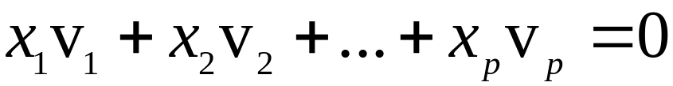
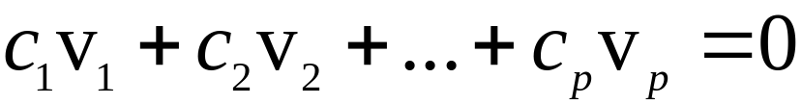
LINEAR INDEPENDENCE
Definition: An indexed set of vectors {v₁, …, v_{p}} in
is said to be linearly independent if the vector equation
has only the trivial solution. The set {v₁, …, v_{p}} is said to be linearly dependent if there exist weights c₁, …, c_{p}, not all zero, such that
----(1)
© 2012 Pearson Education, Inc.
Slide 1.7- <number>

Slide 3
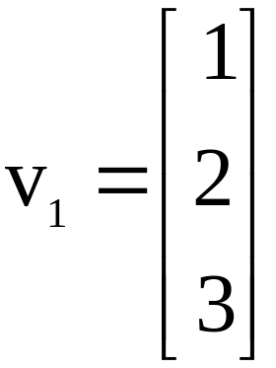
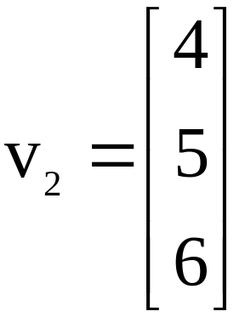
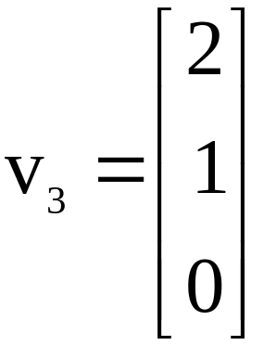
LINEAR INDEPENDENCE
Equation (1) is called a linear dependence relation among v₁, …, v_{p} when the weights are not all zero.
An indexed set is linearly dependent if and only if it is not linearly independent.
Example 1: Let , , and .
© 2012 Pearson Education, Inc.
Slide 1.7- <number>

Slide 4
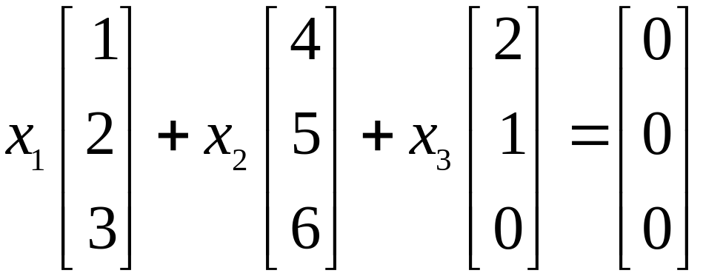
    Determine if the set {v₁, v₂, v₃} is linearly independent.
    If possible, find a linear dependence relation among v₁, v₂, and v₃.
Solution: We must determine if there is a nontrivial solution of the following equation.
© 2012 Pearson Education, Inc.
Slide 1.7- <number>

Slide 5
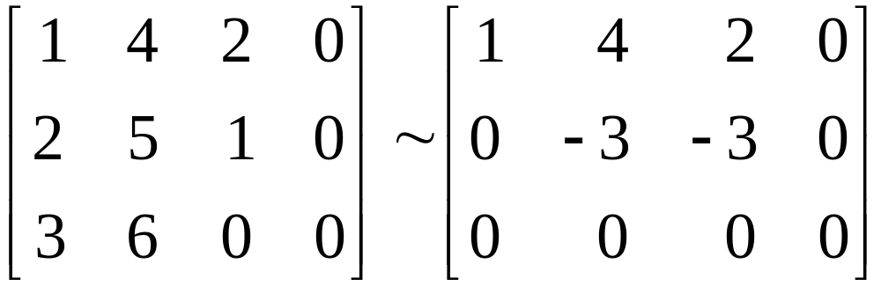
LINEAR INDEPENDENCE
Row operations on the associated augmented matrix show that
.
x₁ and x₂ are basic variables, and x₃ is free.
Each nonzero value of x₃ determines a nontrivial solution of (1).
Hence, v₁, v₂, v₃ are linearly dependent.
© 2012 Pearson Education, Inc.
Slide 1.7- <number>

Slide 6
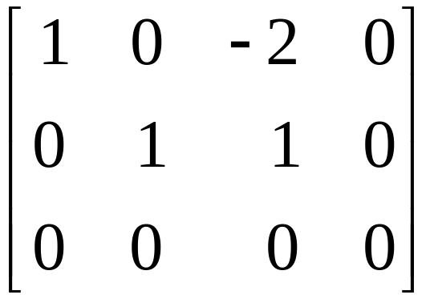
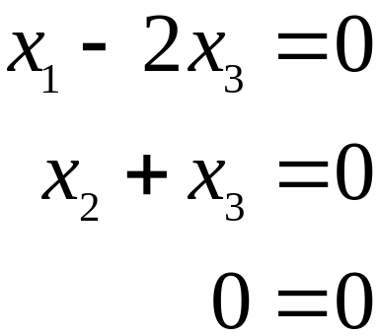





LINEAR INDEPENDENCE
    To find a linear dependence relation among v₁, v₂, and v₃, row reduce the augmented matrix and write the new system:
Thus, , , and x₃ is free.
Choose any nonzero value for x₃—say, .
Then and .
© 2012 Pearson Education, Inc.
Slide 1.7- <number>

Slide 7
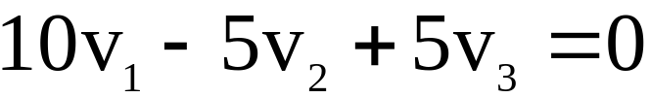
LINEAR INDEPENDENCE
Substitute these values into equation (1) and obtain the equation below.
This is one (out of infinitely many) possible linear dependence relations among v₁, v₂, and v₃.
© 2012 Pearson Education, Inc.
Slide 1.7- <number>

Slide 8
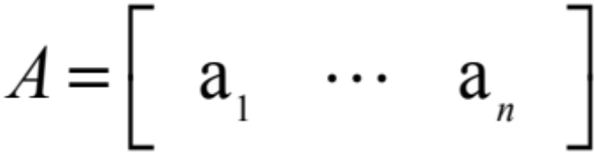

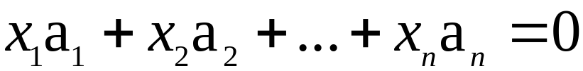
LINEAR INDEPENDENCE OF MATRIX COLUMNS
Suppose that we begin with a matrix
instead of a set of vectors.
The matrix equation can be written as
.
Each linear dependence relation among the columns of A corresponds to a nontrivial solution of .
Thus, the columns of matrix A are linearly independent if and only if the equation has only the trivial solution.
© 2012 Pearson Education, Inc.
Slide 1.7- <number>

Slide 9
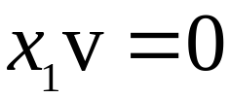

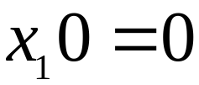
SETS OF ONE OR TWO VECTORS
A set containing only one vector – say, v – is linearly independent if and only if v is not the zero vector.
This is because the vector equation has only the trivial solution when .
The zero vector is linearly dependent because has many nontrivial solutions.
© 2012 Pearson Education, Inc.
Slide 1.7- <number>

Slide 10
SETS OF ONE OR TWO VECTORS
A set of two vectors {v₁, v₂} is linearly dependent if at least one of the vectors is a multiple of the other. Therefore they are linearly dependent if they lie on the same line.
The set is linearly independent if and only if neither of the vectors is a multiple of the other, i.e. if they span a plane.
© 2012 Pearson Education, Inc.
Slide 1.7- <number>

Slide 11
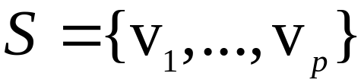
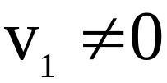

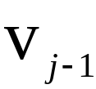
SETS OF TWO OR MORE VECTORS
Theorem 7: Characterization of Linearly Dependent Sets
An indexed set of two or more vectors is linearly dependent if and only if at least one of the vectors in S is a linear combination of the others.
In fact, if S is linearly dependent and , then some v_{j} (with ) is a linear combination of the preceding vectors, v₁, …, .
© 2012 Pearson Education, Inc.
Slide 1.7- <number>

Slide 12
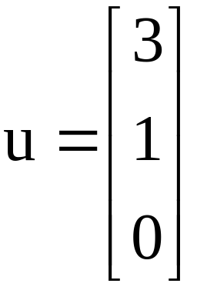
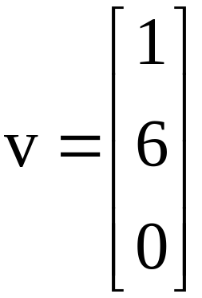
SETS OF TWO OR MORE VECTORS
Theorem 7 does not say that every vector in a linearly dependent set is a linear combination of the preceding vectors.
A vector in a linearly dependent set may fail to be a linear combination of the other vectors.
Example 2: Let and . Describe the
set spanned by u and v, and explain why a vector w is in Span {u, v} if and only if {u, v, w} is linearly dependent.
© 2012 Pearson Education, Inc.
Slide 1.7- <number>

Slide 13



SETS OF TWO OR MORE VECTORS
Solution: The vectors u and v are linearly independent because neither vector is a multiple of the other, and so they span a plane in .
Span {u, v} is the x₁x₂-plane (with ).
If w is a linear combination of u and v, then {u, v, w} is linearly dependent, by Theorem 7.
Conversely, suppose that {u, v, w} is linearly dependent.
By theorem 7, some vector in {u, v, w} is a linear combination of the preceding vectors (since ).
That vector must be w, since v is not a multiple of u.
© 2012 Pearson Education, Inc.
Slide 1.7- <number>

Slide 14
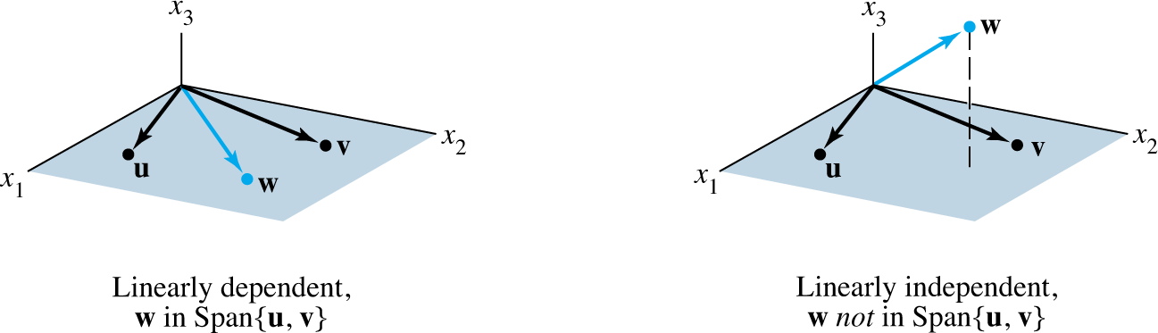

SETS OF TWO OR MORE VECTORS
So w is in Span {u, v}. See the figures given below.
Example 2 generalizes to any set {u, v, w} in with u and v linearly independent.
The set {u, v, w} will be linearly dependent if and only if w is in the plane spanned by u and v.
© 2012 Pearson Education, Inc.
Slide 1.7- <number>

Slide 15

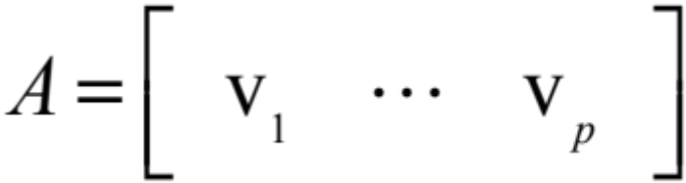

SETS OF TWO OR MORE VECTORS
Theorem 8: If a set contains more vectors than there are entries in each vector, then the set is linearly dependent. That is, any set {v₁, …, v_{p}} in is linearly dependent if .
Proof: Let .
Then A is , and the equation corresponds to a system of n equations in p unknowns.
If , there are more variables than equations, so there must be a free variable.
© 2012 Pearson Education, Inc.
Slide 1.7- <number>

Slide 16
Linear Equations in Linear Algebra
INTRODUCTION TO LINEAR TRANSFORMATIONS
© 2012 Pearson Education, Inc.

Slide 17


LINEAR TRANSFORMATIONS
A transformation (or function or mapping) T from to is a rule that assigns to each vector x in a vector T (x) in .
The set is called domain of T, and is called the codomain of T.
The notation indicates that the domain of T is and the codomain is .
For x in , the vector T (x) in is called the image of x (under the action of T ).
The set of all images T (x) is called the range of T. See the figure on the next slide.
© 2012 Pearson Education, Inc.
Slide 1.8- <number>

Slide 18
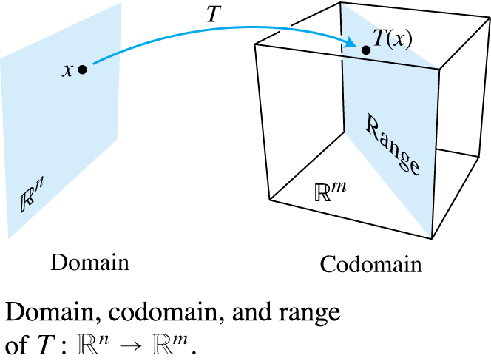


MATRIX TRANSFORMATIONS
For each x in , T (x) is computed as Ax, where A is an
matrix.
For simplicity, we denote such a matrix transformation by .
The domain of T is when A has n columns and the codomain of T is when each column of A has m entries.
© 2012 Pearson Education, Inc.
Slide 1.8- <number>

Slide 19
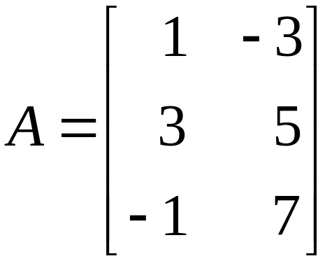
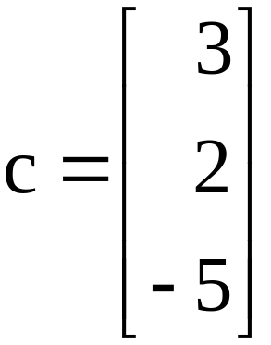
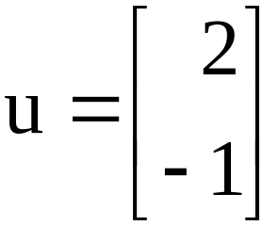


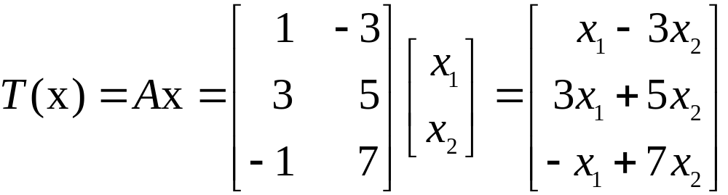
MATRIX TRANSFORMATIONS
The range of T is the set of all linear combinations of the columns of A, because each image T (x) is of the form Ax.
Example 1: Let , , .
and define a transformation by , so that
.
© 2012 Pearson Education, Inc.
Slide 1.8- <number>

Slide 20

MATRIX TRANSFORMATIONS
    Find T (u), the image of u under the transformation T.
    Find an x in whose image under T is b.
    Is there more than one x whose image under T is b?
    Determine if c is in the range of the transformation T.
© 2012 Pearson Education, Inc.
Slide 1.8- <number>

Slide 21
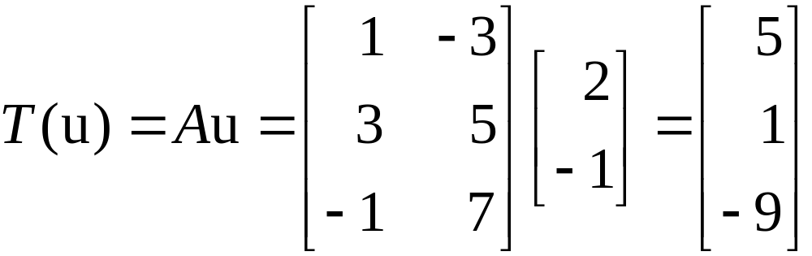


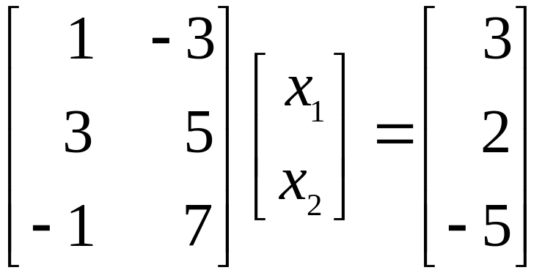
MATRIX TRANSFORMATIONS
Solution:
    Compute
    .
    Solve for x. That is, solve , or
    . ----(1)
© 2012 Pearson Education, Inc.
Slide 1.8- <number>

Slide 22
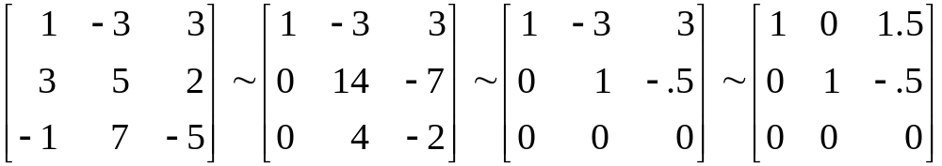
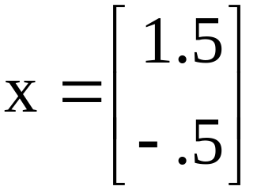
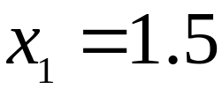
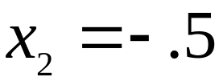
MATRIX TRANSFORMATIONS
      Row reduce the augmented matrix:
----(2)
      Hence , , and .
      The image of this x under T is the given vector b.
© 2012 Pearson Education, Inc.
Slide 1.8- <number>

Slide 23


MATRIX TRANSFORMATIONS
    Any x whose image under T is b must satisfy equation (1).
      From (2), it is clear that equation (1) has a unique solution.
      So there is exactly one x whose image is b.
    The vector c is in the range of T if c is the image of some x in , that is, if for some x.
      This is another way of asking if the system
      is consistent.
© 2012 Pearson Education, Inc.
Slide 1.8- <number>

Slide 24
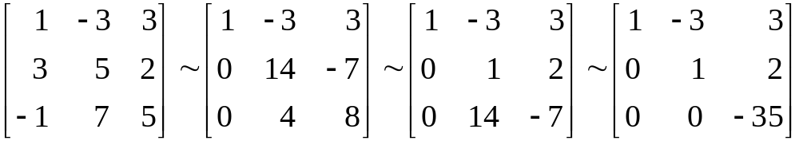

MATRIX TRANSFORMATIONS
      To find the answer, row reduce the augmented matrix.
      The third equation, , shows that the system is inconsistent.
      So c is not in the range of T.
© 2012 Pearson Education, Inc.
Slide 1.8- <number>

Slide 25
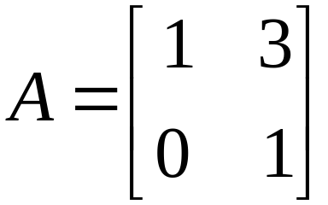


SHEAR TRANSFORMATION
Example 2: Let . The transformation
defined by is called a shear transformation.
It can be shown that if T acts on each point in the
square shown in the figure on the next slide, then the set of images forms the shaded parallelogram.
© 2012 Pearson Education, Inc.
Slide 1.8- <number>

Slide 26
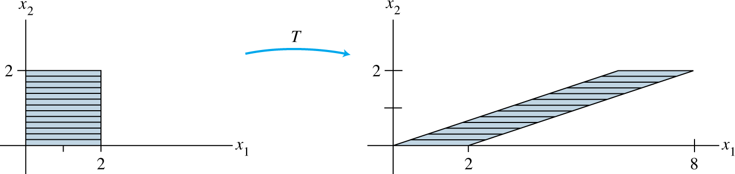
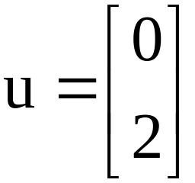
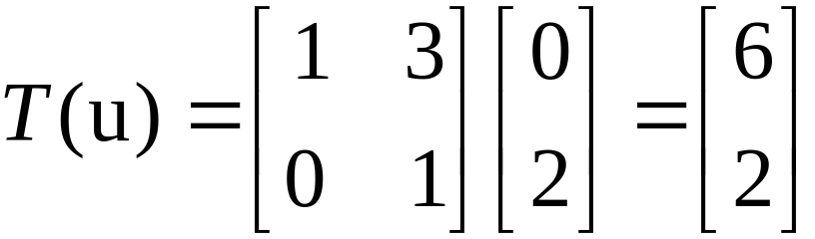
SHEAR TRANSFORMATION
The key idea is to show that T maps line segments onto line segments and then to check that the corners of the square map onto the vertices of the parallelogram.
For instance, the image of the point is
,
© 2012 Pearson Education, Inc.
Slide 1.8- <number>

Slide 27

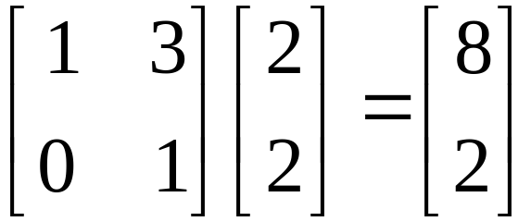


LINEAR TRANSFORMATIONS
and the image of is .
T deforms the square as if the top of the square were pushed to the right while the base is held fixed.
Definition: A transformation (or mapping) T is linear if:
    for all u, v in the domain of T;
    for all scalars c and all u in the domain of T.
© 2012 Pearson Education, Inc.
Slide 1.8- <number>

Slide 28


LINEAR TRANSFORMATIONS
Linear transformations preserve the operations of vector addition and scalar multiplication.
Property (i) says that the result of first adding u and v in and then applying T is the same as first applying T to u and v and then adding T (u) and T (v) in .
These two properties lead to the following useful facts.
If T is a linear transformation, then
----(3)
© 2012 Pearson Education, Inc.
Slide 1.8- <number>

Slide 29



LINEAR TRANSFORMATIONS
and . ----(4)
for all vectors u, v in the domain of T and all scalars c, d.
Property (3) follows from condition (ii) in the definition, because .
Property (4) requires both (i) and (ii):
If a transformation satisfies (4) for all u, v and c, d, it must be linear.
(Set for preservation of addition, and set for
preservation of scalar multiplication.)
© 2012 Pearson Education, Inc.
Slide 1.8- <number>

Slide 30
LINEAR TRANSFORMATIONS
Repeated application of (4) produces a useful generalization:
----(5)
In engineering and physics, (5) is referred to as a superposition principle.
Think of v₁, …, v_{p} as signals that go into a system and T (v₁), …, T (v_{p}) as the responses of that system to the signals.
© 2012 Pearson Education, Inc.
Slide 1.8- <number>

Slide 31



LINEAR TRANSFORMATIONS
The system satisfies the superposition principle if whenever an input is expressed as a linear combination of such signals, the system’s response is the same linear combination of the responses to the individual signals.
Given a scalar r, define by .
T is called a contraction when and a dilation when .
© 2012 Pearson Education, Inc.
Slide 1.8- <number>

Slide 32


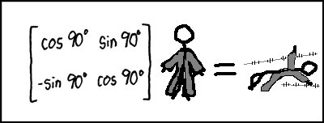
Rotations
A linear transformation of the form
is called a rotation by the angle
© 2012 Pearson Education, Inc.
Slide 1.4- <number>

